Slide 1
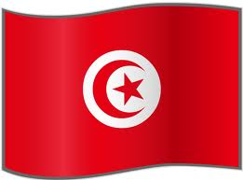
Tunisia
The National Constituent Assembly of Tunisia began discussing the constitution in February 2012, the role of religion in the state specifically, whether to make reference to sharia in the constitution was poised to be the most divisive political issue. But now that the assembly’s leading party, Nemaha, has opposed any reference to sharia, the way is clear for the discussion in the assembly to turn more technical.

Slide 2
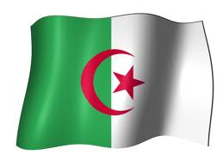
Algeria
The Department of State continues to warn U.S. citizens of the risks of travel to Algeria. This replaces the Travel Warning for Algeria dated January 19, 2013, to update information on the current security situation in Algeria, the continuing threat posed by terrorism, and to reiterate information on security incidents and recommendations on security awareness.

Slide 3
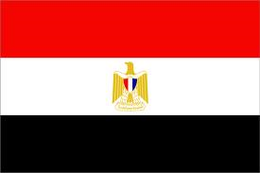
Egypt
Long known for its pyramids and ancient civilization, Egypt is the largest Arab country and has played a central role in Middle Eastern politics in modern times. In the 1950s President Gamal Abdul Nasser pioneered Arab nationalism and the non-aligned movement, while his successor Anwar Sadat made peace with Israel and turned back to the West.

Slide 4
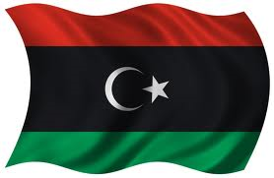
Libya
Libya, a mostly desert and oil-rich country on the southern shores of the Mediterranean Sea with an ancient history, has more recently been renowned for the 42-year rule of the mercurial Col Muammar Gaddafi.

Slide 5
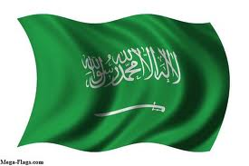
Saudi Arabia
One of the most devout and insular countries in the Middle East, Saudi Arabia has emerged from being an underdeveloped desert kingdom to become one of the wealthiest nations in the region thanks to vast oil resources.

Slide 6
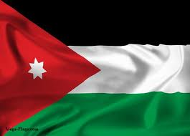
Jordan
The Hashemite Kingdom of Jordan is a small country with few natural resources, but it has played a pivotal role in the struggle for power in the Middle East. Jordan's significance results partly from its strategic location at the crossroads of what Christians, Jews and Muslims call the Holy Land. It is a key ally of the US and, together with Egypt, one of only two Arab nations to have made peace with Israel.

Slide 7
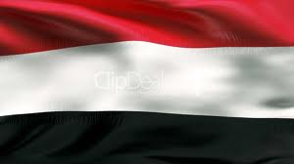
Yemen
Yemen has been at the crossroads of Africa, the Middle East and Asia for thousands of years thanks to its position on the ancient spice routes. It is one of the possible locations for the Biblical kingdom of Sheba.

Slide 8
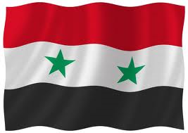
Syria
Syria covers an area that has seen invasions and occupations over the ages, from Romans and Mongols to Crusaders and Turks. A country of fertile plains, high mountains and deserts, it is home to diverse ethnic and religious groups, including Kurds, Armenians, Assyrians, Christians, Druze, Alawite Shias and Arab Sunnis, the last of who make up a majority of the Muslim population.

